Slide 1
How to host a Zoom meeting with one device streaming sound and a different one the video

Slide 2
If the speaker of the meeting is far away from the webcam or microphone of the laptop, you may choose to use a different device to capture sound. It will have better quality, specially in a big room.
This tutorial will explain how to set up and host a meeting using an iphone to capture sound and a laptop to run the meeting and capture video.

Slide 3
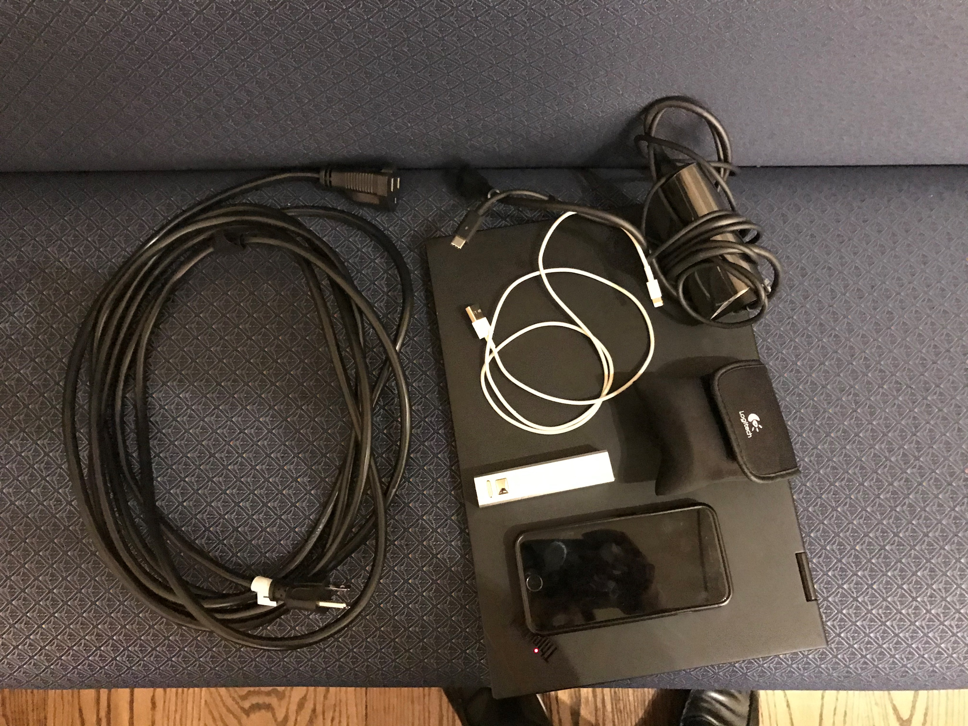
Material needed
Laptop power cord
Laptop with Zoom App
webcam
Iphone power source
Iphone with Zoom App

Slide 4
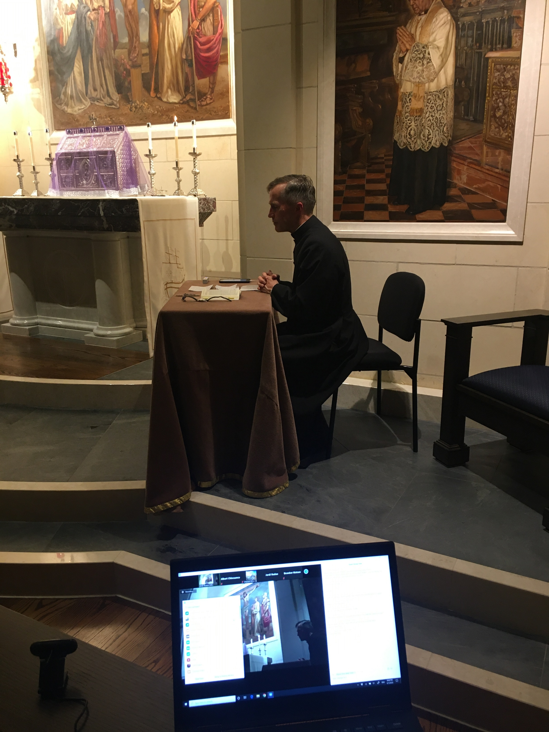
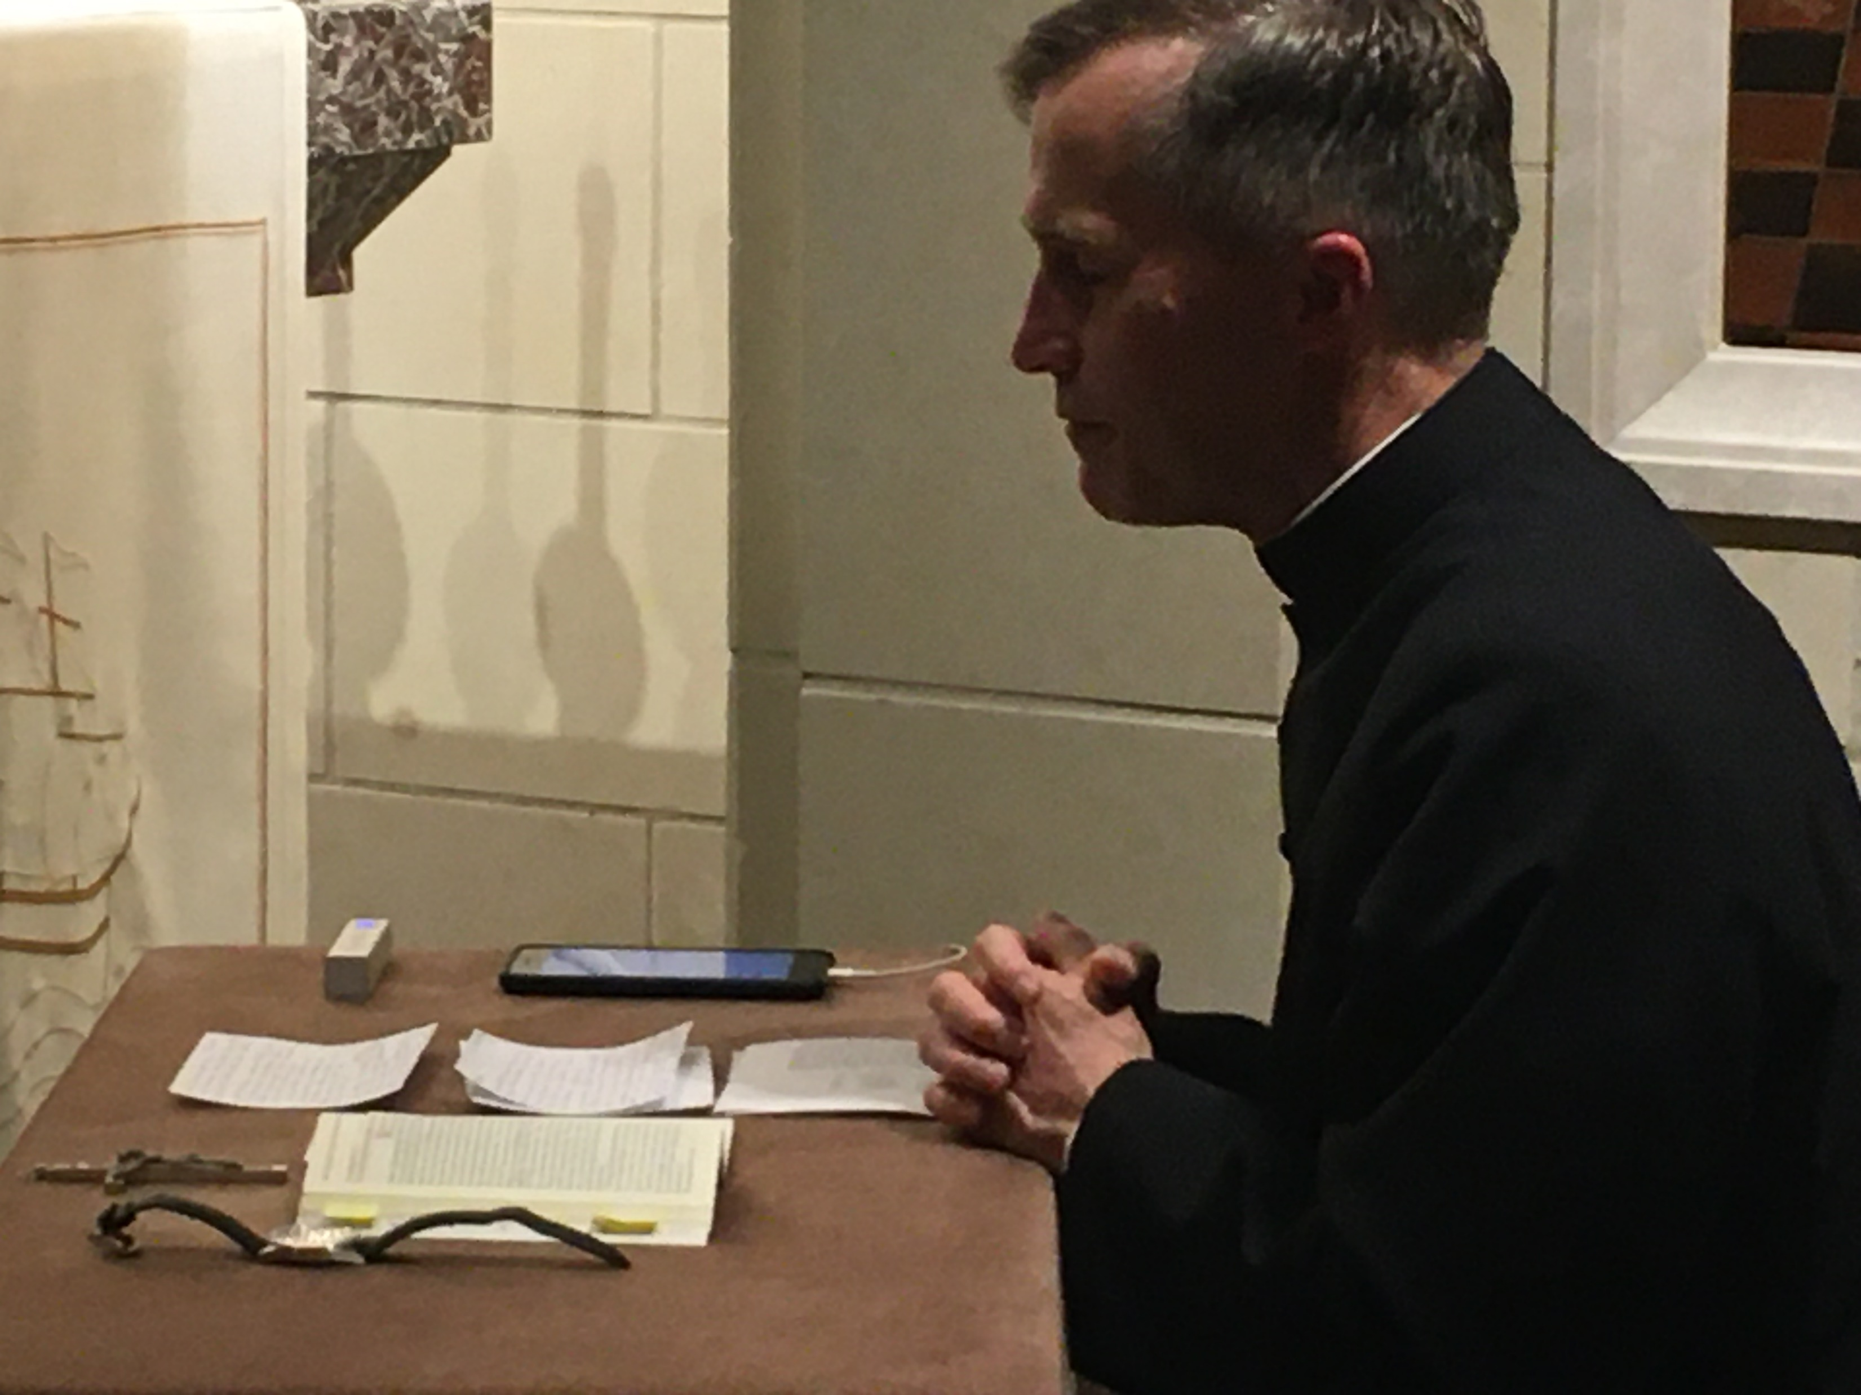
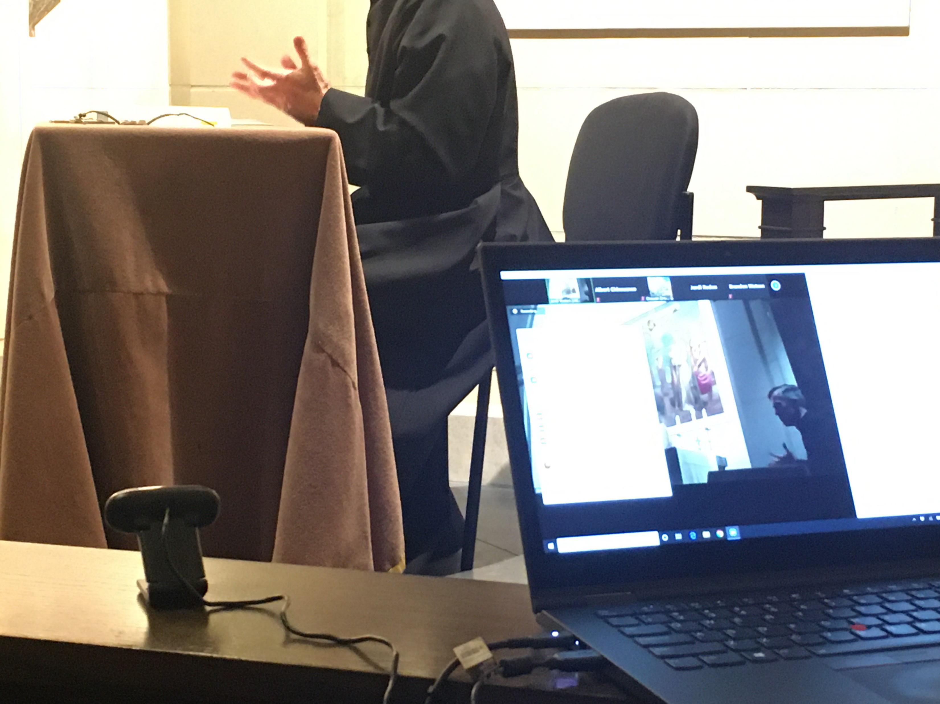
Setting up the hardware
Make sure that the laptop and the iPHONE are connected to a power source. For the iPHONE, a powerbank is preferable, to provide some mobility in case the speaker is moving around.
AUDIO
VIDEO
iPHONE
Webcam and Laptop

Slide 5
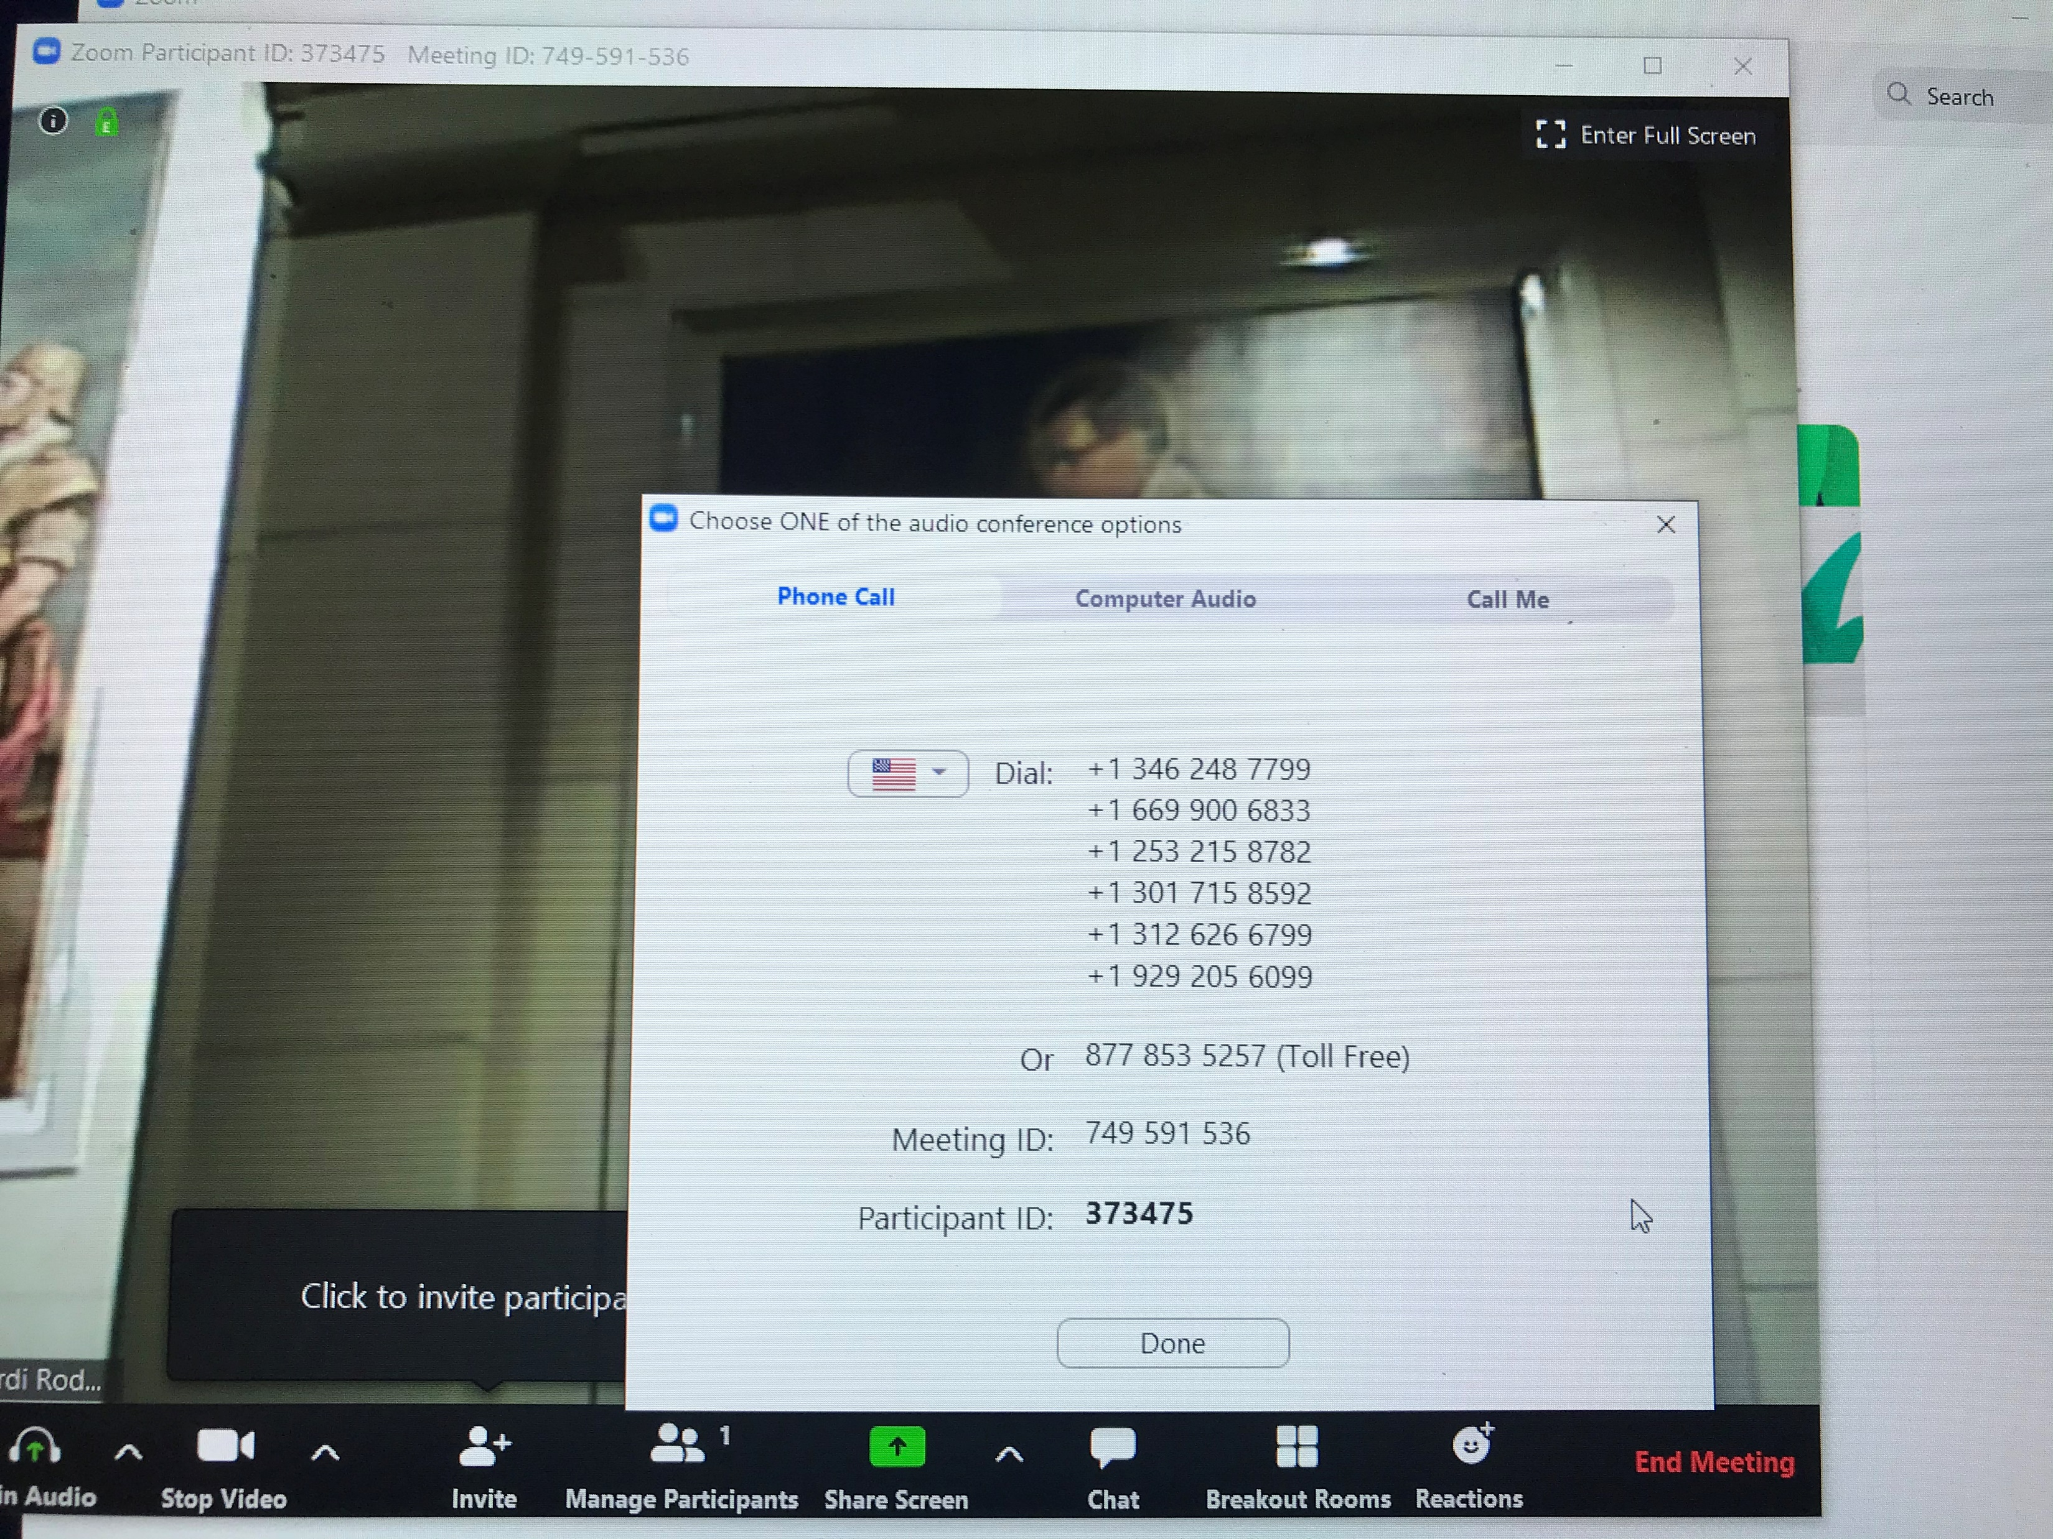
Setting up the software
IMAGE
From the laptop, you will set up the HOST account.
Log in to Zoom, using the host code or ask the organizer to grant you host privileges. You do not need audio in the laptop (all communications with the HOST need to be done by the CHAT feature of Zoom.
It is very important, to avoid echo, that the laptop has the speakers muted and the microphone muted. It is better to not activate audio at all in this account. One option is to chose “Join audio by calling in (and do not call in) (fig 1).
When prompted, mute all attendees to avoid background noise during broadcast. You can do that from the PARTICIPANTS screen.
Set up the camera. It seems more versatile for the coordinator of the meeting, to use an independent camera (not built-in) since you may need to use the laptop to mute and unmute users and that could move the image if you use built-in cameras.
The HOST can chose one of the images as the main one (otherwise the main image will be switching form user to user depending on where the sound is coming). For having the image of the camera as the main display, the HOST can PIN the image coming from the camera, or MAKE SPOTLIGHT. The HOST can access those features clicking on the (…) in the image of interest, opening the menu of options.

Slide 6
Setting up the software
SOUND
From the iphone, log in to Zoom.
Turn off the camera and turn off the volume, since you will use this device only as microphone (it can be very distracting to the presenter if background noise is coming from the iphone).
Unmute this device.

Slide 7
Managing the meeting
TESTING
Set up the laptop so you can see what is being streaming.
From the Laptop, ensure that everybody is on mute. See in ATTENDEES that the microphones are muted except the iphone that is broadcasting the sound.
Make a sound test, asking the audience using the CHAT that the sound works well.
RUNNING THE MEETING
Record the meeting if needed. It will produce a large file, so think twice if needed.
Mute and unmute participants as needed.
Use the CHAT for communication.

Slide 8
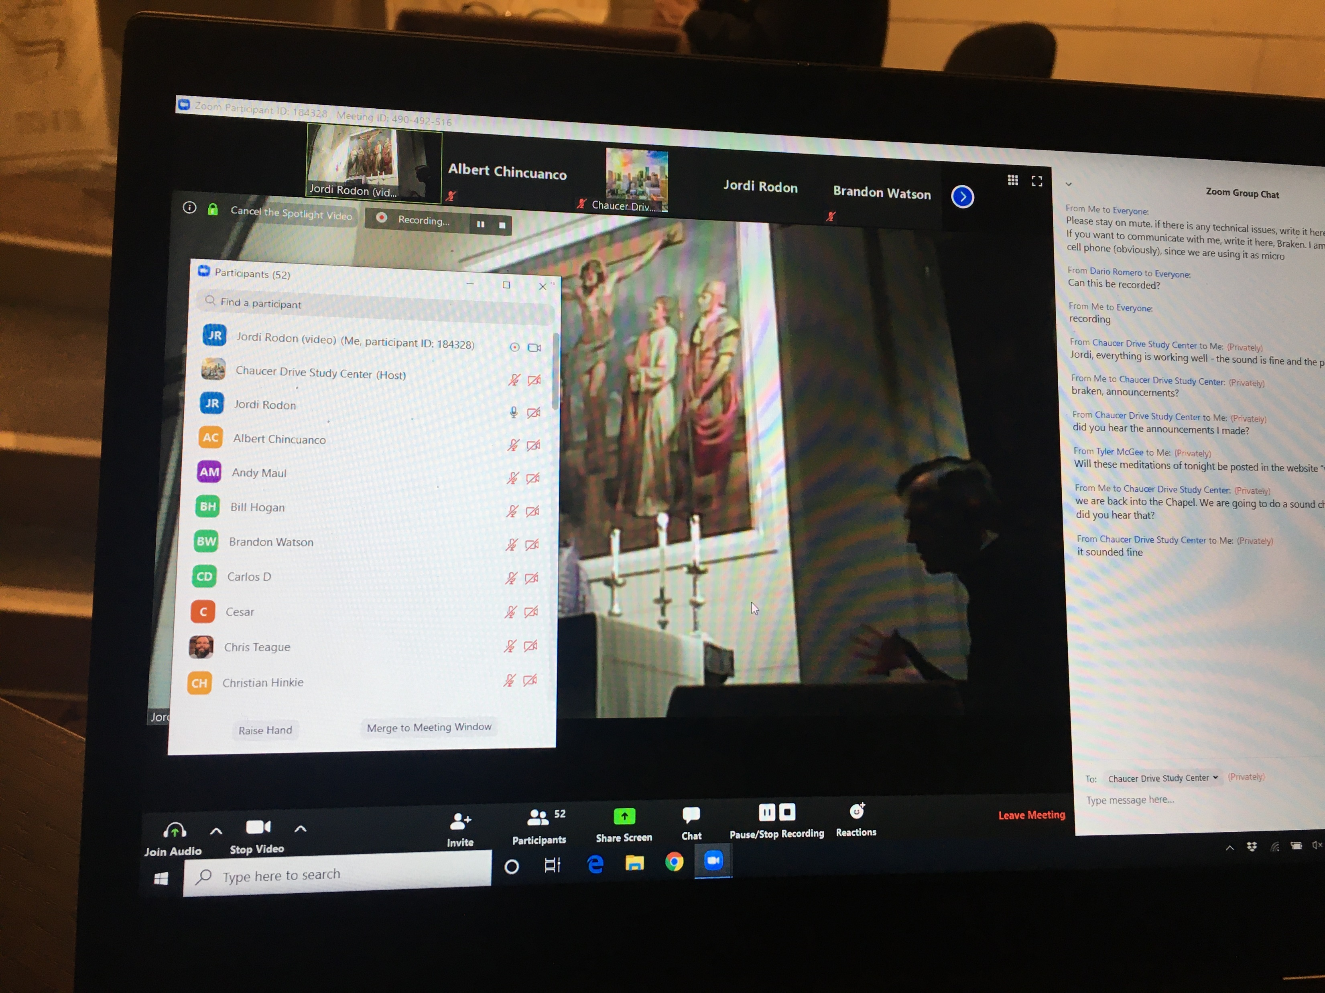
Laptop for the manager of the meeting

Slide 9
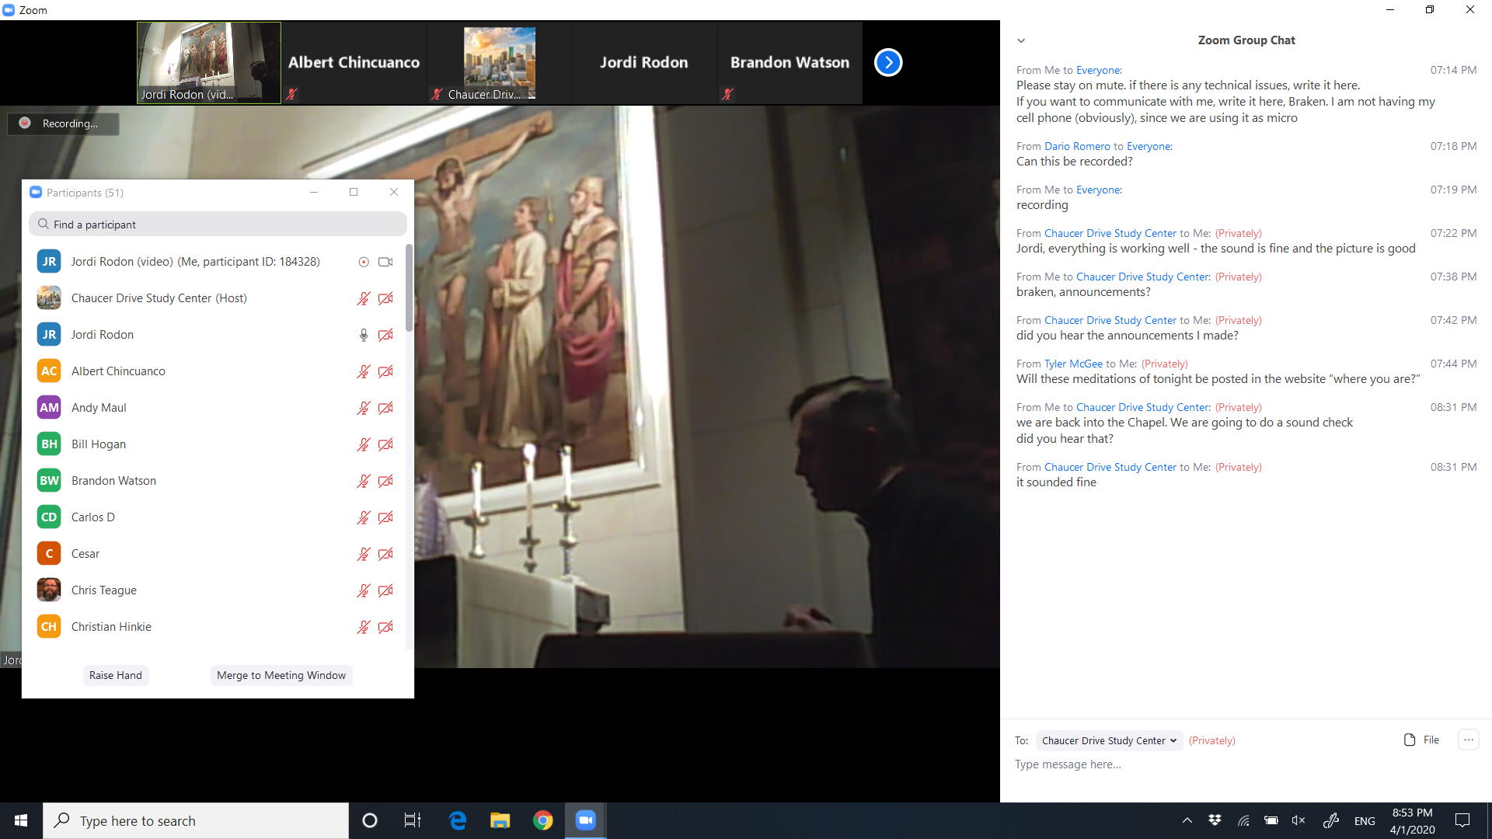
PARTICIPANTS
(mute or unmute as needed)
Pinned video
COMMUNICATION WITH PARTICIPANTS
VIDEO STREAMING

